Slide 1

Premium House Lights
By Max Daguste

Slide 2
Introduction
I'm Max Daguste, a cybersecurity analyst specializing in incident response. Today, I'll share insights into the Premium House Lights Inc. incident, where I used tools like Wireshark, Nmap, and log analysis tools to unravel the timeline of events.
Before we delve into this intriguing case, let me briefly share my journey. I began as an addiction counselor, helping individuals reclaim their lives. However, my fascination with technology propelled me into the world of cybersecurity. Through academic endeavors, I honed skills in tools like Wireshark, Nmap, and Linux.
This unique blend of counseling expertise and cybersecurity knowledge allows me to approach incidents holistically, addressing both technical and human aspects. Now, armed with this diverse skill set, let's dive into the Premium House Lights Inc. incident without further ado.

Slide 3
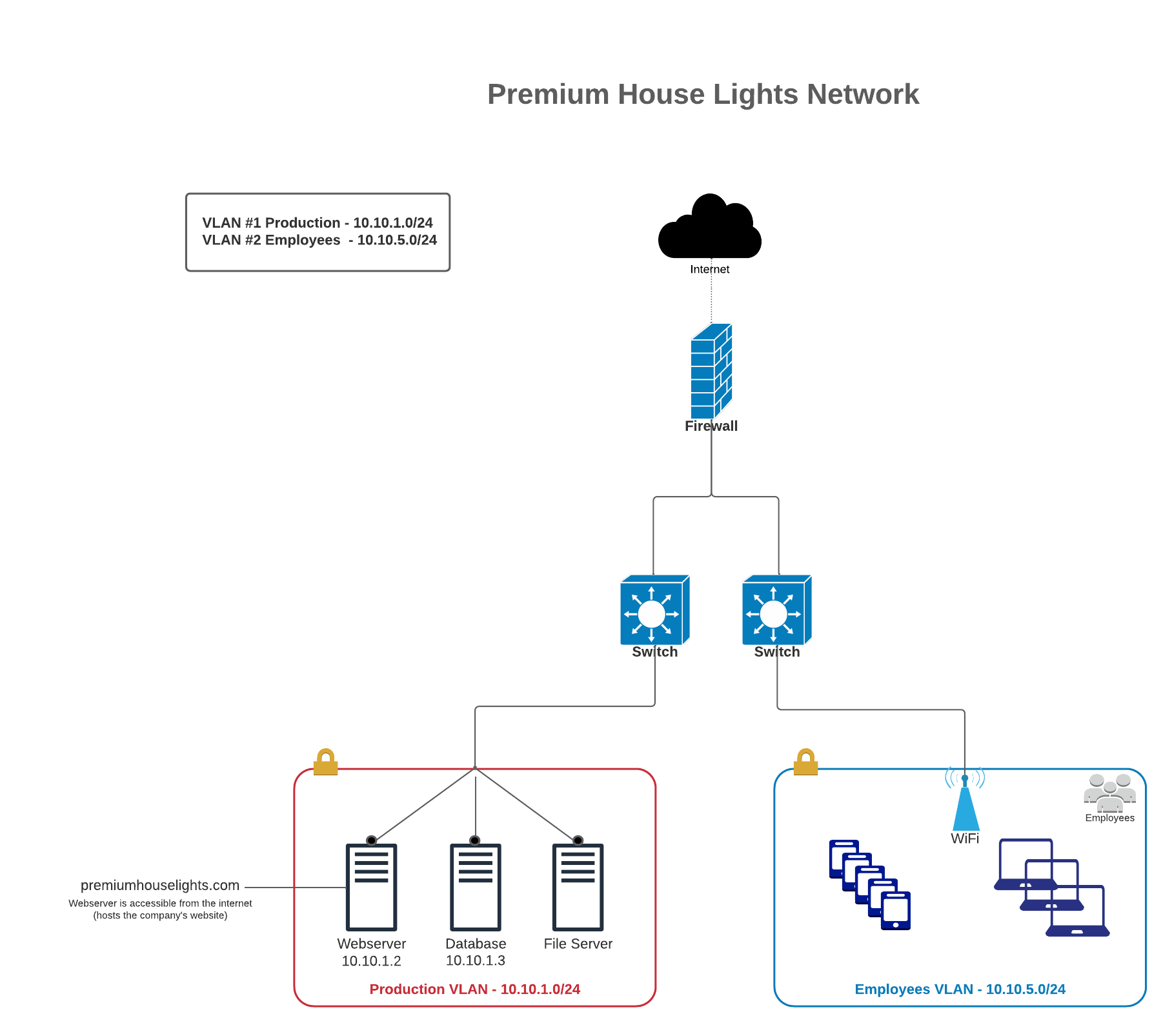
Premium House Lights Network layout

Slide 4
Attack Timeline and Methodology
Initial web server compromise through port 4444 using bot [02/19/22 – 21:56]
Attacker IP: 138.68.92.163 targeting Webserver IP: 134.122.33.221
Privilege escalation and Lateral Movement [02/19/22 – 21:59 The attacker performed an NMAP scan and identified the database host [10.10.1.3] and the open ports (namely port 23)
Database Access [02/19/22 – 21:59] The attacker established a telnet connection to the database server due to poor password practice. The login being “phl” and password “phl123”
Ransomware demand
Data Exfiltration [02/19/22 – 22:02]
the attacker retrieved sensitive data from the database and exfiltrated it to an external server at IP address 178.62.228.28.
Covering their track [02/19/22 – 22:02]:
The attacker did not try to cover or conceal their tracks in any way that we are aware of. However, they did delete all the data from the clients from the system, but made a backup for themselves first

Slide 5
Recommendation
Network Segmentation: Divide your network into segments with varying security requirements to limit lateral movement for attackers.
Firewalls: Deploy firewalls at network entry and exit points. Configure them to block unnecessary ports and services.
IDS/IPS: Implement intrusion detection and prevention systems to monitor network traffic for threats and block suspicious activity.
Access Control: Enforce strong access control policies, including Multi-Factor Authentication (MFA) for server access.
Security Monitoring: Set up monitoring tools and maintain detailed logs to detect and respond to unusual or malicious activity.
File Upload Security: If your web application allows file uploads, implement strict validation and security measures.
Authentication and Passwords: Enforce strong password policies, use authentication tokens for external applications, and change default credentials for database interfaces.
Database Auditing: Comply with industry regulations (e.g., PCI DSS), and conduct regular security audits and assessments

